Slide 1
Cannabis Considerations in Indiana: Insights about Consumption and Neighboring States
Anna Newell, M.A.
Advisors: Beau Kilmer and Greg Midgette

Slide 2


About me
Criminology Ph.D. student at Pennsylvania State University
Research focused on drug policy and substance use
RAND work: Indiana Cannabis Project

Slide 3
Indiana Cannabis Project
Evaluation of potential implications of cannabis legalization in Indiana
Description of various regulatory frameworks
Assessment of measures related to health, crime, and economics
Unique characteristics of existing cannabis policy in Indiana

Slide 4
Indiana Cannabis Policy Landscape
Restrictive laws surrounding medical and recreational cannabis (Blanchette et al. 2024)
2018 Farm Bill: Legalized THC products containing <=0.3% delta-9 THC
Hemp-derived THC products legal under the 2018 Farm Bill

Slide 5
My Contributions
1) Verifying the status of dispensaries near Indiana
2) Mapping dispensary locations
3) Assessment of cannabis use prevalence in Indiana and border states

Slide 6
Dispensary Verification
Obtained active recreational licenses from Illinois, Michigan, and Ohio
Obtained addresses and phone numbers
Called each store to verify hours and address

Slide 7
Dispensary Verification
Illinois
  Started with 253 licenses
  118 dispensaries within 50 miles of border
    36 of those were in Chicago
  1 was closed
Michigan
  Started with 2,535 licenses
  164 dispensaries within 50 miles of border
  3 were closed, 1 was online only
Ohio
  Started with 149 licenses
  39 dispensaries within 50 miles of border
  3 were closed, 1 was medical only

Slide 8
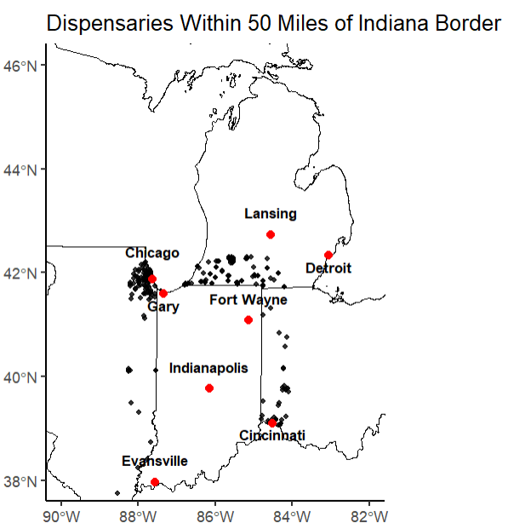
Mapping

Slide 9
Spatial Analysis
312 dispensaries are within 50 miles of the border of Indiana
46% of Indiana’s population lives within 50 miles of a dispensary in another state

Slide 10
Cannabis Use Prevalence
National Survey on Drug Use and Health (NSDUH)
Behavioral Risk Factor Surveillance Survey (BRFSS)
Number of days used in past month
Past month use
Past year use
Past month use
Past year use

Slide 11
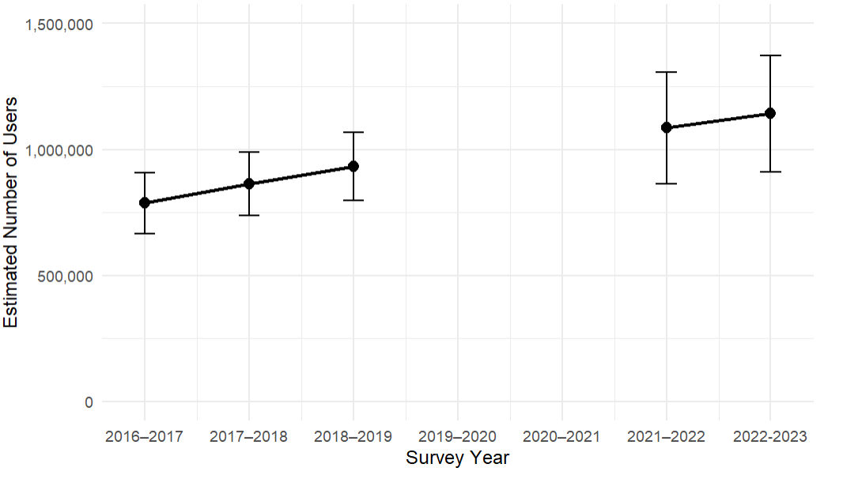
Past Year Cannabis Use – NSDUH

Slide 12
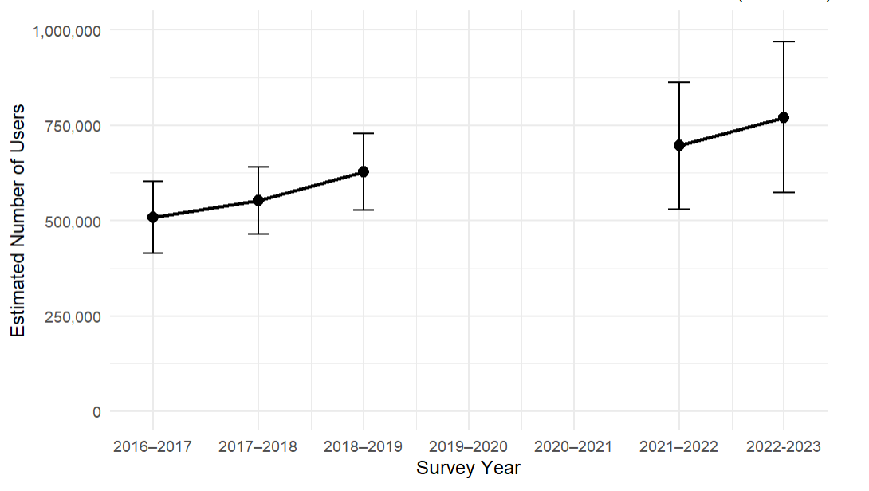
Past Month Cannabis – NSDUH

Slide 13
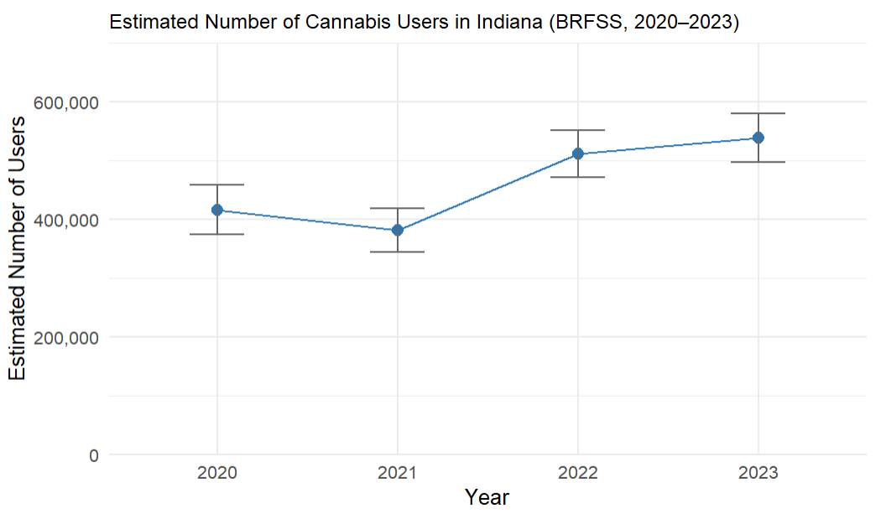
Past Month Use – BRFSS

Slide 14
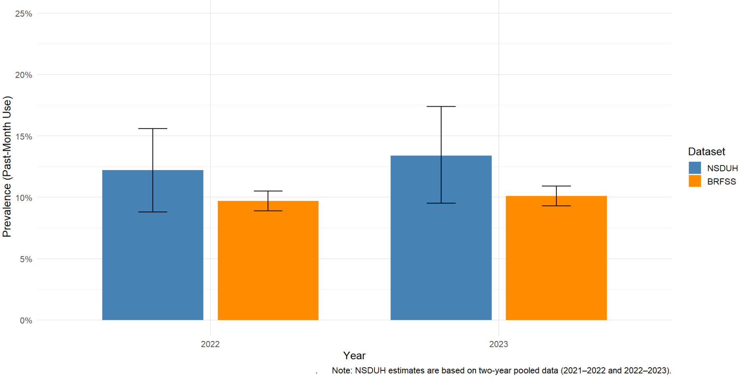
BRFSS and NSDUH Prevalence Estimates

Slide 15
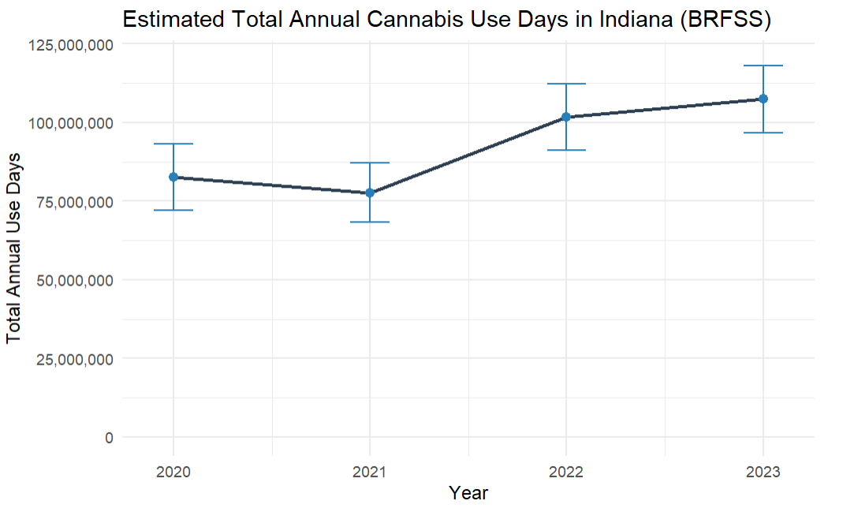
Annual Use Days – BRFSS

Slide 16
Comparison of Cannabis Use in Indiana and Border States
Number of Past Year Users, NSDUH 2022-2023 Two Year Estimates.
 | Prevalence | 95% CI
Indiana | 0.199 | (0.149, 0.249)
Illinois | 0.236 | (0.192, 0.280)
Kentucky | 0.177 | (0.138, 0.216)
Ohio | 0.230 | (0.193, 0.268)
Michigan | 0.263 | (0.226, 0.300)

Slide 17
Comparison of Cannabis Use in Indiana and Border States
Number of Past Month Users, NSDUH 2022-2023 Two Year Estimates.
 | Prevalence | 95% CI
Indiana | 0.134 | (0.095, 0.174)
Illinois | 0.172 | (0.138, 0.207)
Kentucky | 0.117 | (0.087, 0.148)
Ohio | 0.156 | (0.129, 0.184)
Michigan | 0.192 | (0.163, 0.222)

Slide 18
Key Takeaways
Steady increase in cannabis use in recent years
Cannabis currently accessible to Indiana residents
Cannabis policy changes in Indiana will determine where supply comes from

Slide 19
Next Steps
Break down prevalence by age groups
Assess driving distance between Indiana border and dispensary locations
Consideration of out of state residents coming to Indiana to purchase cannabis

Slide 20
Thank you for attending and thank you to my wonderful advisors Beau Kilmer and Greg Midgette for a great summer!

Slide 21
Past Month Use Prevalence
 | BRFSS |  |  | NSDUH
 | Prevalence | Prevalence SE | Prevalence CI | Prevalence | Prevalence SE | Prevalence CI
2018 | NA | NA | NA | 0.099 | 0.009 | (0.082, 0.117)
2019 | NA | NA | NA | 0.112 | 0.010 | (0.093, 0.132)
2020 | 0.080 | 0.004 | (0.072, 0.088) | NA | NA | NA
2021 | 0.073 | 0.004 | (0.066, 0.080) | NA | NA | NA
2022 | 0.097 | 0.004 | (0.089, 0.105) | 0.122 | 0.017 | (0.088, 0.156)
2023 | 0.101 | 0.004 | (0.093, 0.109) | 0.134 | 0.020 | (0.095, 0.174)

